Slide 1
IDA-ML1 Challenge
Emanuele De Rossi

Slide 2
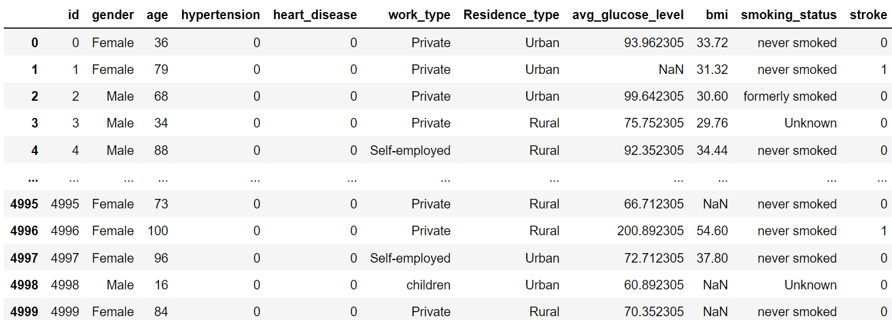
Dataset

Slide 3
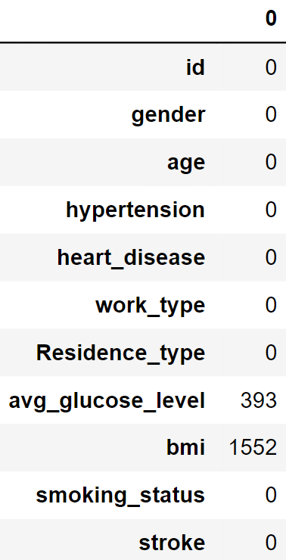
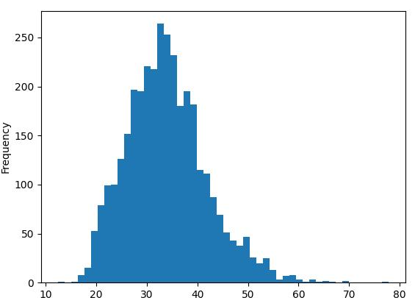
NaN values
On the dataset, only abg_glucose_level and bmi have missing values.
In the dataset, 1552/5000 instances do not have bmi.
Different ways to deal with NaN values:
Eliminite rows or columns that contain missing values
Replace missing values with other values: I decided to replace the NaN values with the median of the columns (not the mean because of the high variance) →
Another missing value is the «Unknow» value on smoking_status. I just replaced that value with 0s when converting categorical to numerical value
BMI distribution

Slide 4
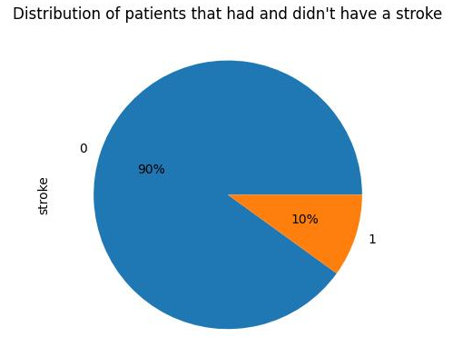
Unbalanced dataset
The main problem on our dataset is that the distribution on the target variable (stroke vs no stroke) is unbalanced.
This is problematic because, if we have a lot less positive instances than negatives, our ML model will learn a lot of from the negative instances, and «overlook» the positive samples.
So I upsampled the minority class by duplicating instances, so that we have a 50/50 distribution of stroke/no stroke instances

Slide 5
Model choice?
I decided to use random forests because:
Generally high acccuracy,
They are less likely to overfit, if compared to individual decision trees
Fairly easy to implement and train: no need to normalize/standardize the data, training individual trees can be done in parallel (faster training)
Explainability: using random forests we can easily extract the feature importance (which features have the most significant impact on the model’s predictions)

Slide 6
Model training
param_grid = {
'n_estimators': [20, 50, 100, 200, 300, 500, 1000],
'max_depth': [None, 10, 20, 30, 40],
'min_samples_split': [3, 5, 10, 15, 20],
'min_samples_leaf': [3, 5, 10, 15, 20]
}
After dividing into the training set into train and evaluation, I upsampled the minority class by duplicating instances.
Then, I used the GridSearchCV method from sklearn, that performs hyperparameter tuning by searching most performant combination of the given hyperameters. The method uses cross-validation (in my case, I used a 5-fold cross validation).
Best parameters
{'max_depth': None, 'min_samples_leaf': 5, 'min_samples_split': 5, 'n_estimators': 300}
The performance of the model on the AUC ROC is 0.85 on the evaluation data (20% split on training data)

Slide 7
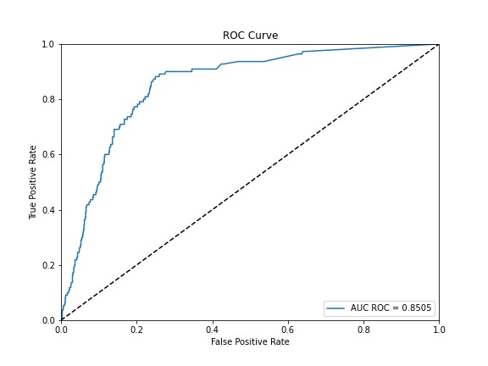
ROC curve performance

Slide 8
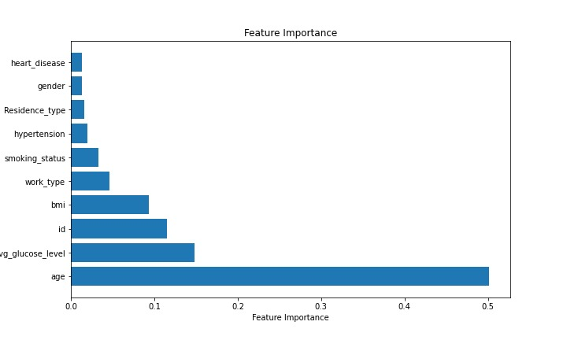
Feature importance representation

